Slide 1
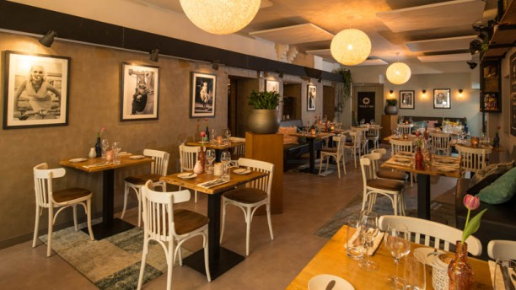

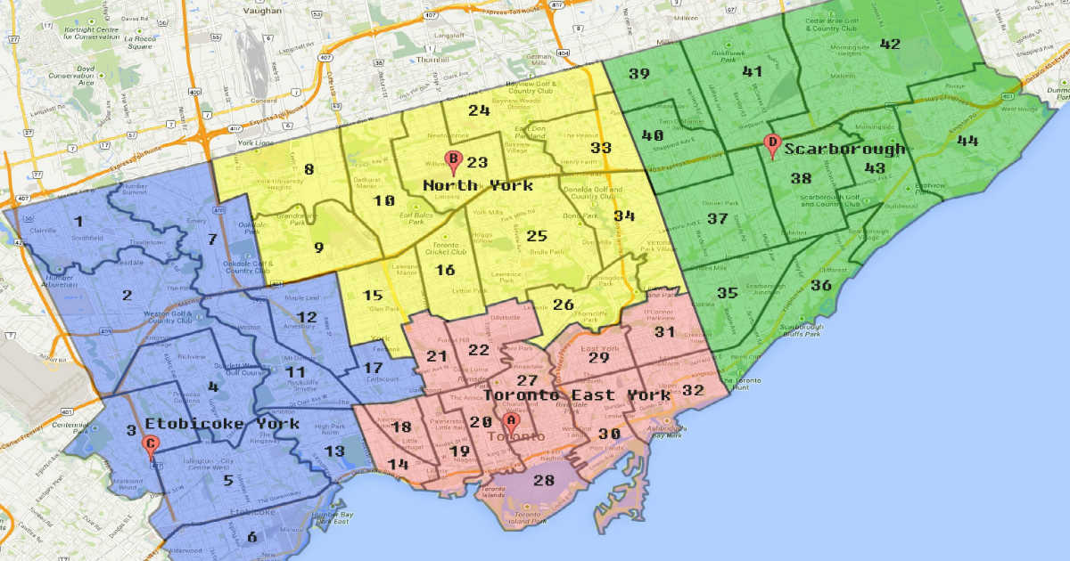
My friend could not decide which type of the restaurant and also which neighborhood she should place the investment.
She needs some relevant analysis about the characteristics, trends the area.

Slide 2

Data
List of Toronto’s boroughs: https://en.wikipedia.org/wiki/List_of_postal_codes_of_Canada:_M
Toronto’s coordinate:
http://cocl.us/Geospatial_data
Foursquare platform: including location, local search, and venue ratings

Slide 3
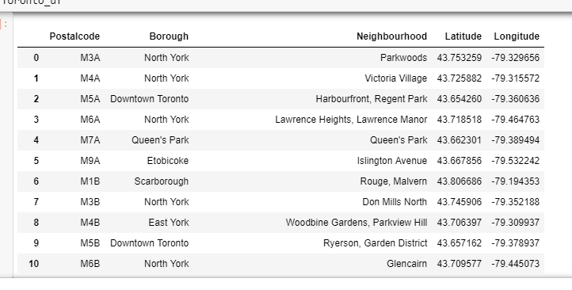
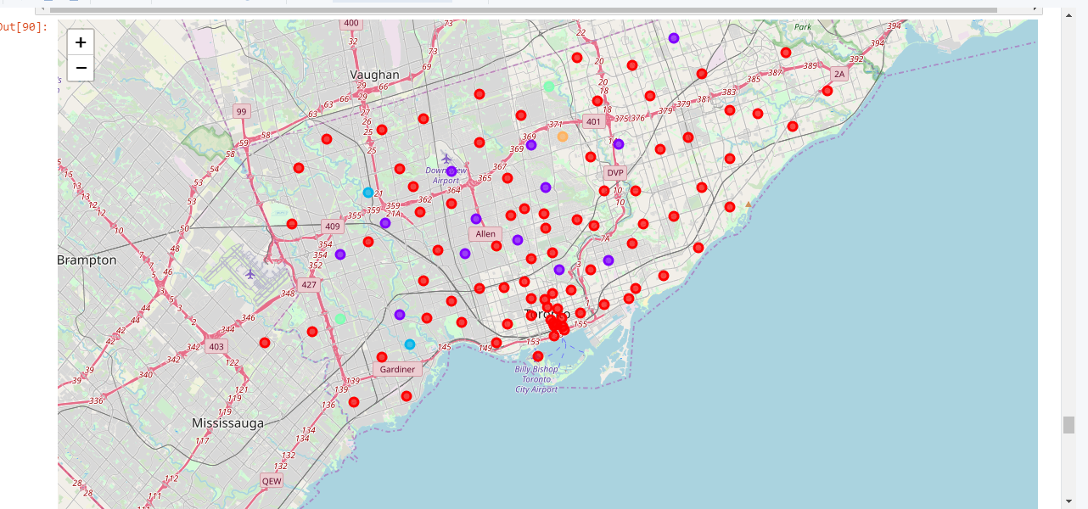
Data
Merging the cleaned list of Toronto’s boroughs and its coordinates.
Using Foursquare platform to identify the nearby venues in each area.

Slide 4
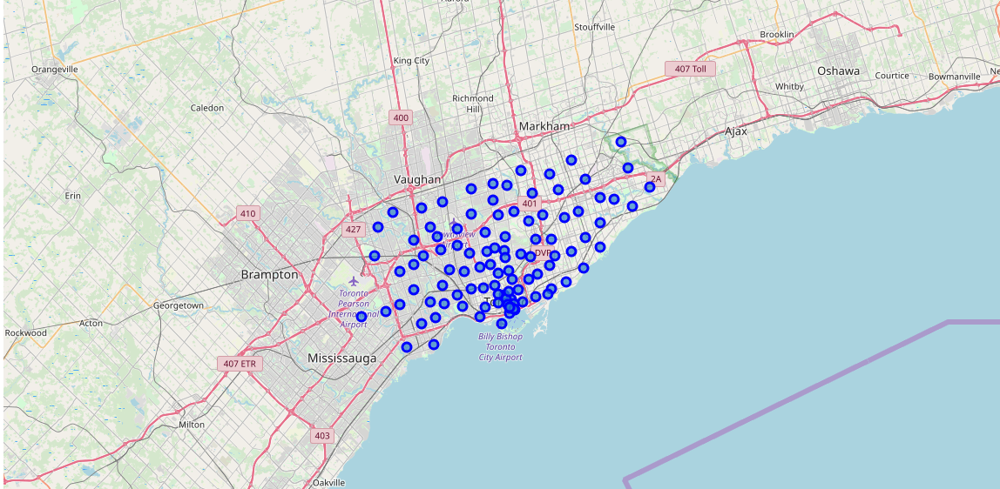
Methodology
Folium is a great choice for the purpose of mapping in this analysis.

Slide 5
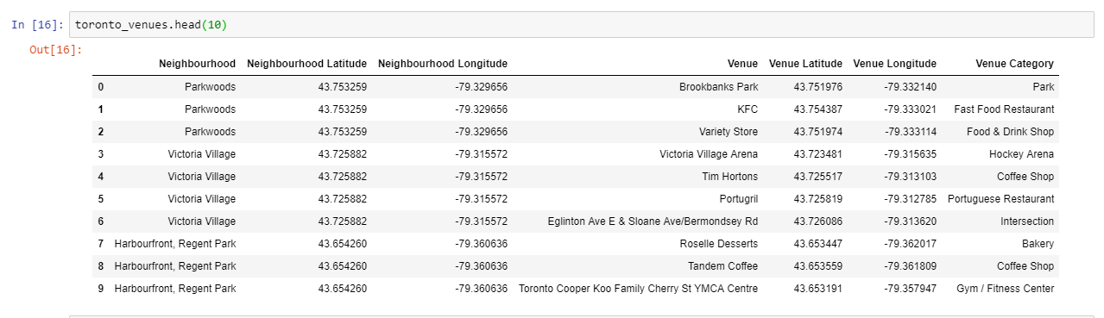
Methodology
I used Foursquare to get the information of nearby venues including the name, its coordinate, and the category.

Slide 6
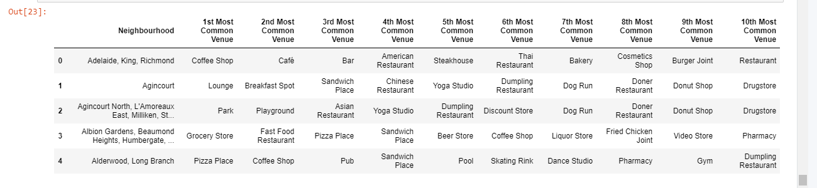
Methodology
We get the top 10 most common venues of each area

Slide 7
Methodology
Finally, I have tried to examine clusters in these neighborhoods to see how similar objects are grouped in one cluster

Slide 8
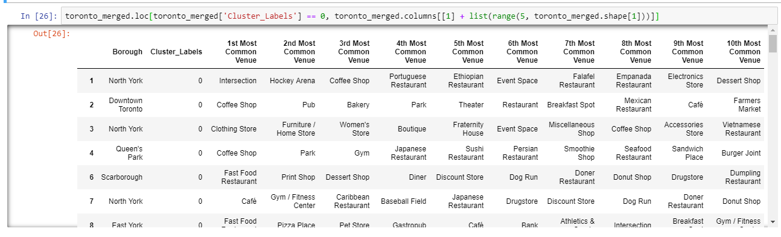
Results
The most crowded area in Toronto is in Downtown in Old Toronto.
Restaurants, coffee shops are the most common

Slide 9
Conclusion
Restaurant and coffee shop should be placed in the downtown

